Slide 1




1756 to 1783
Chapter 13
THE FRENCH REVOLUTION
the french revolution
Strand Three: The History of Europe and the Wider World
@MsDoorley

Slide 2

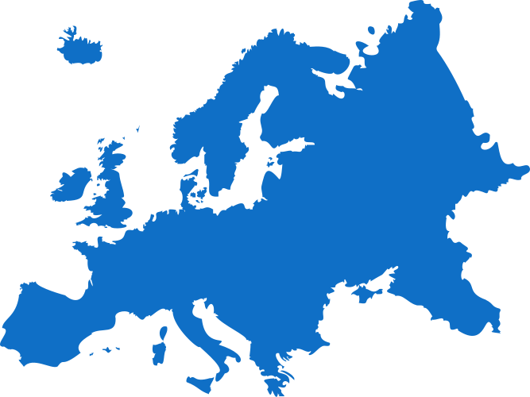

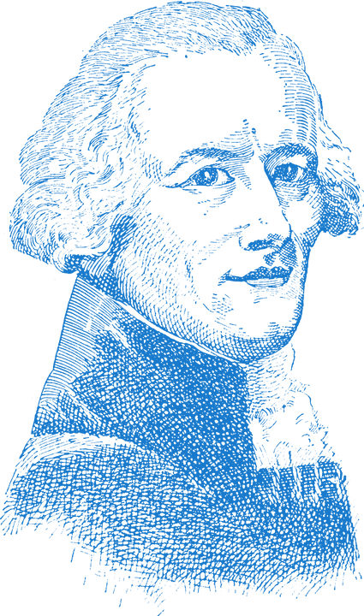


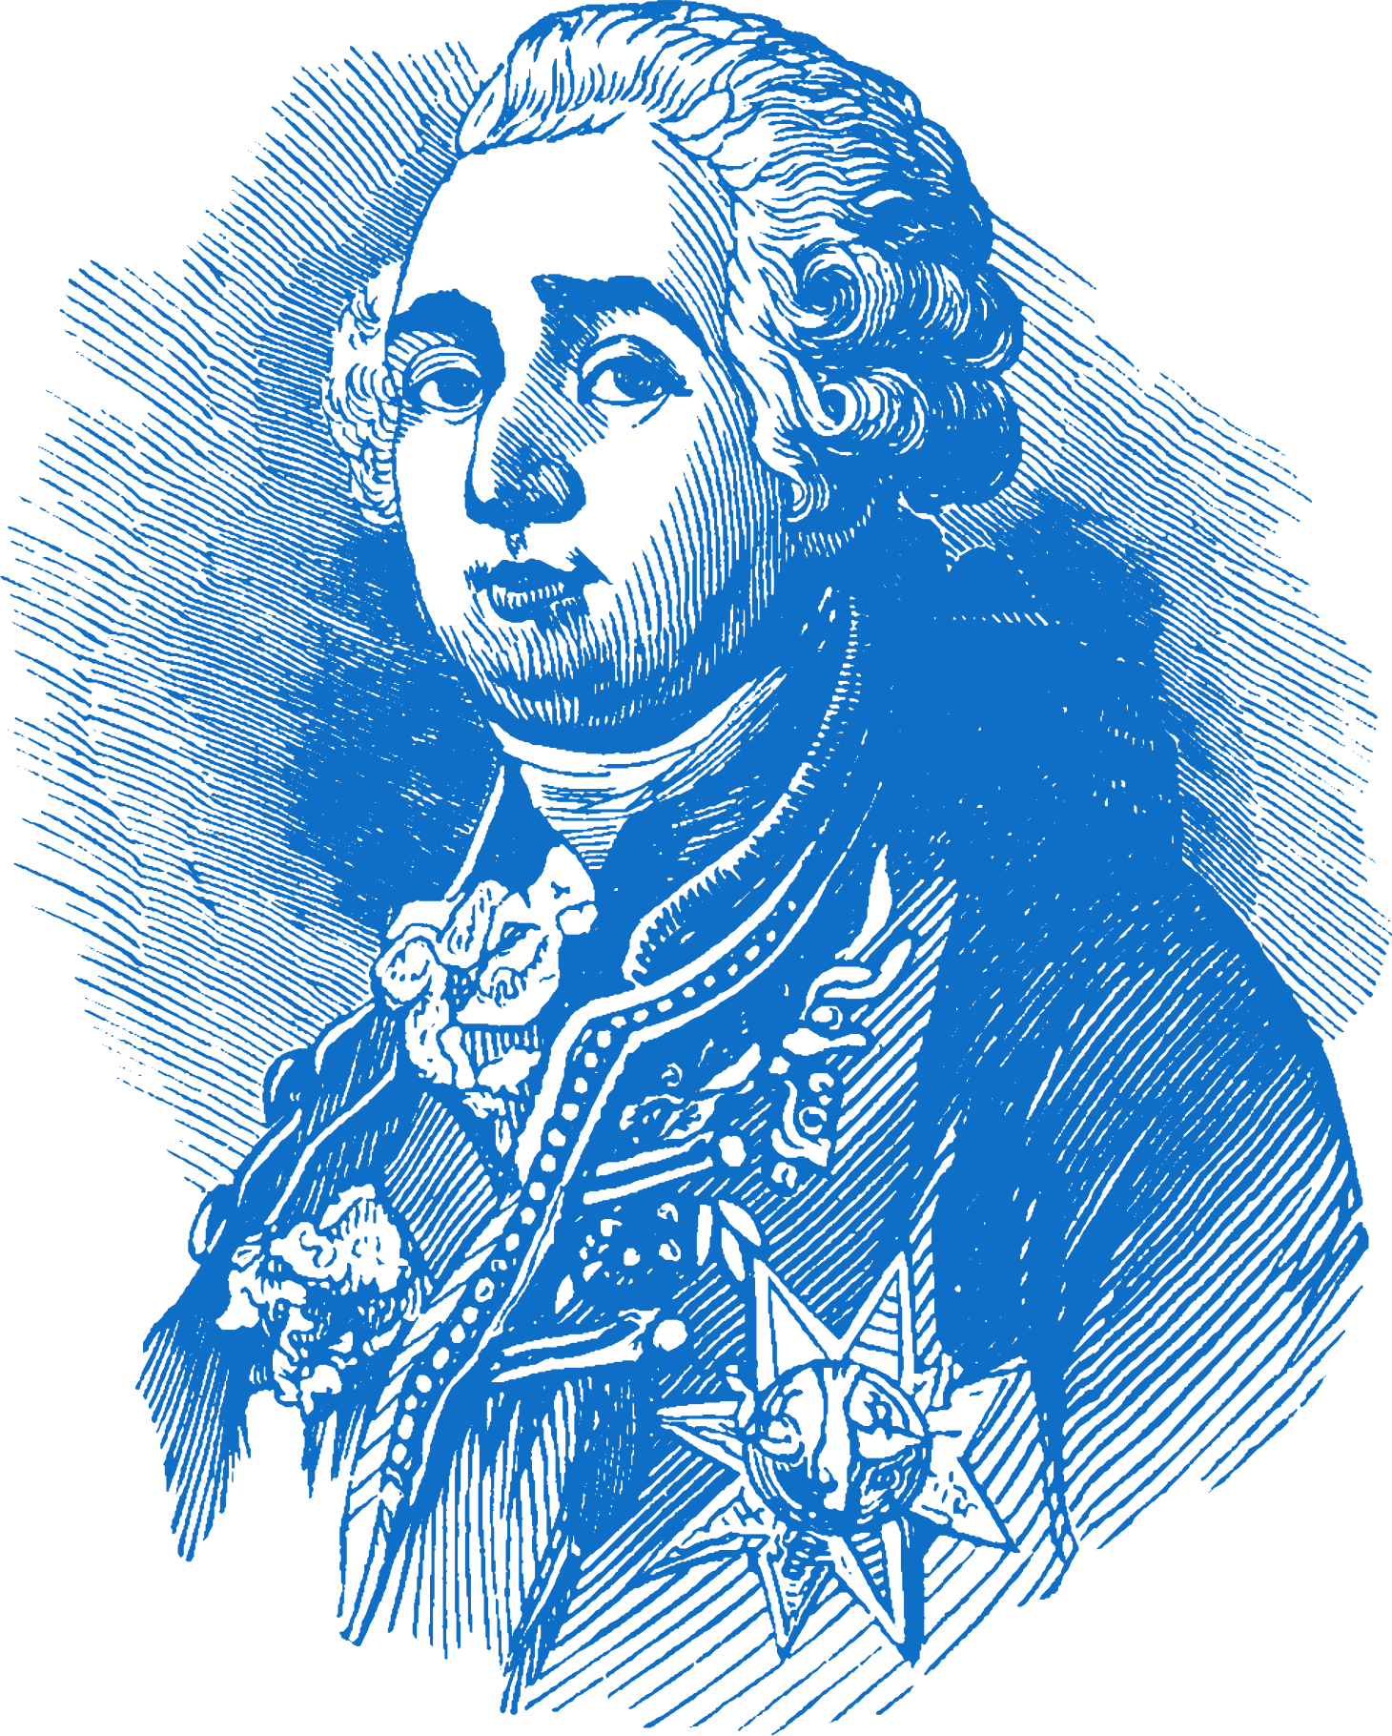
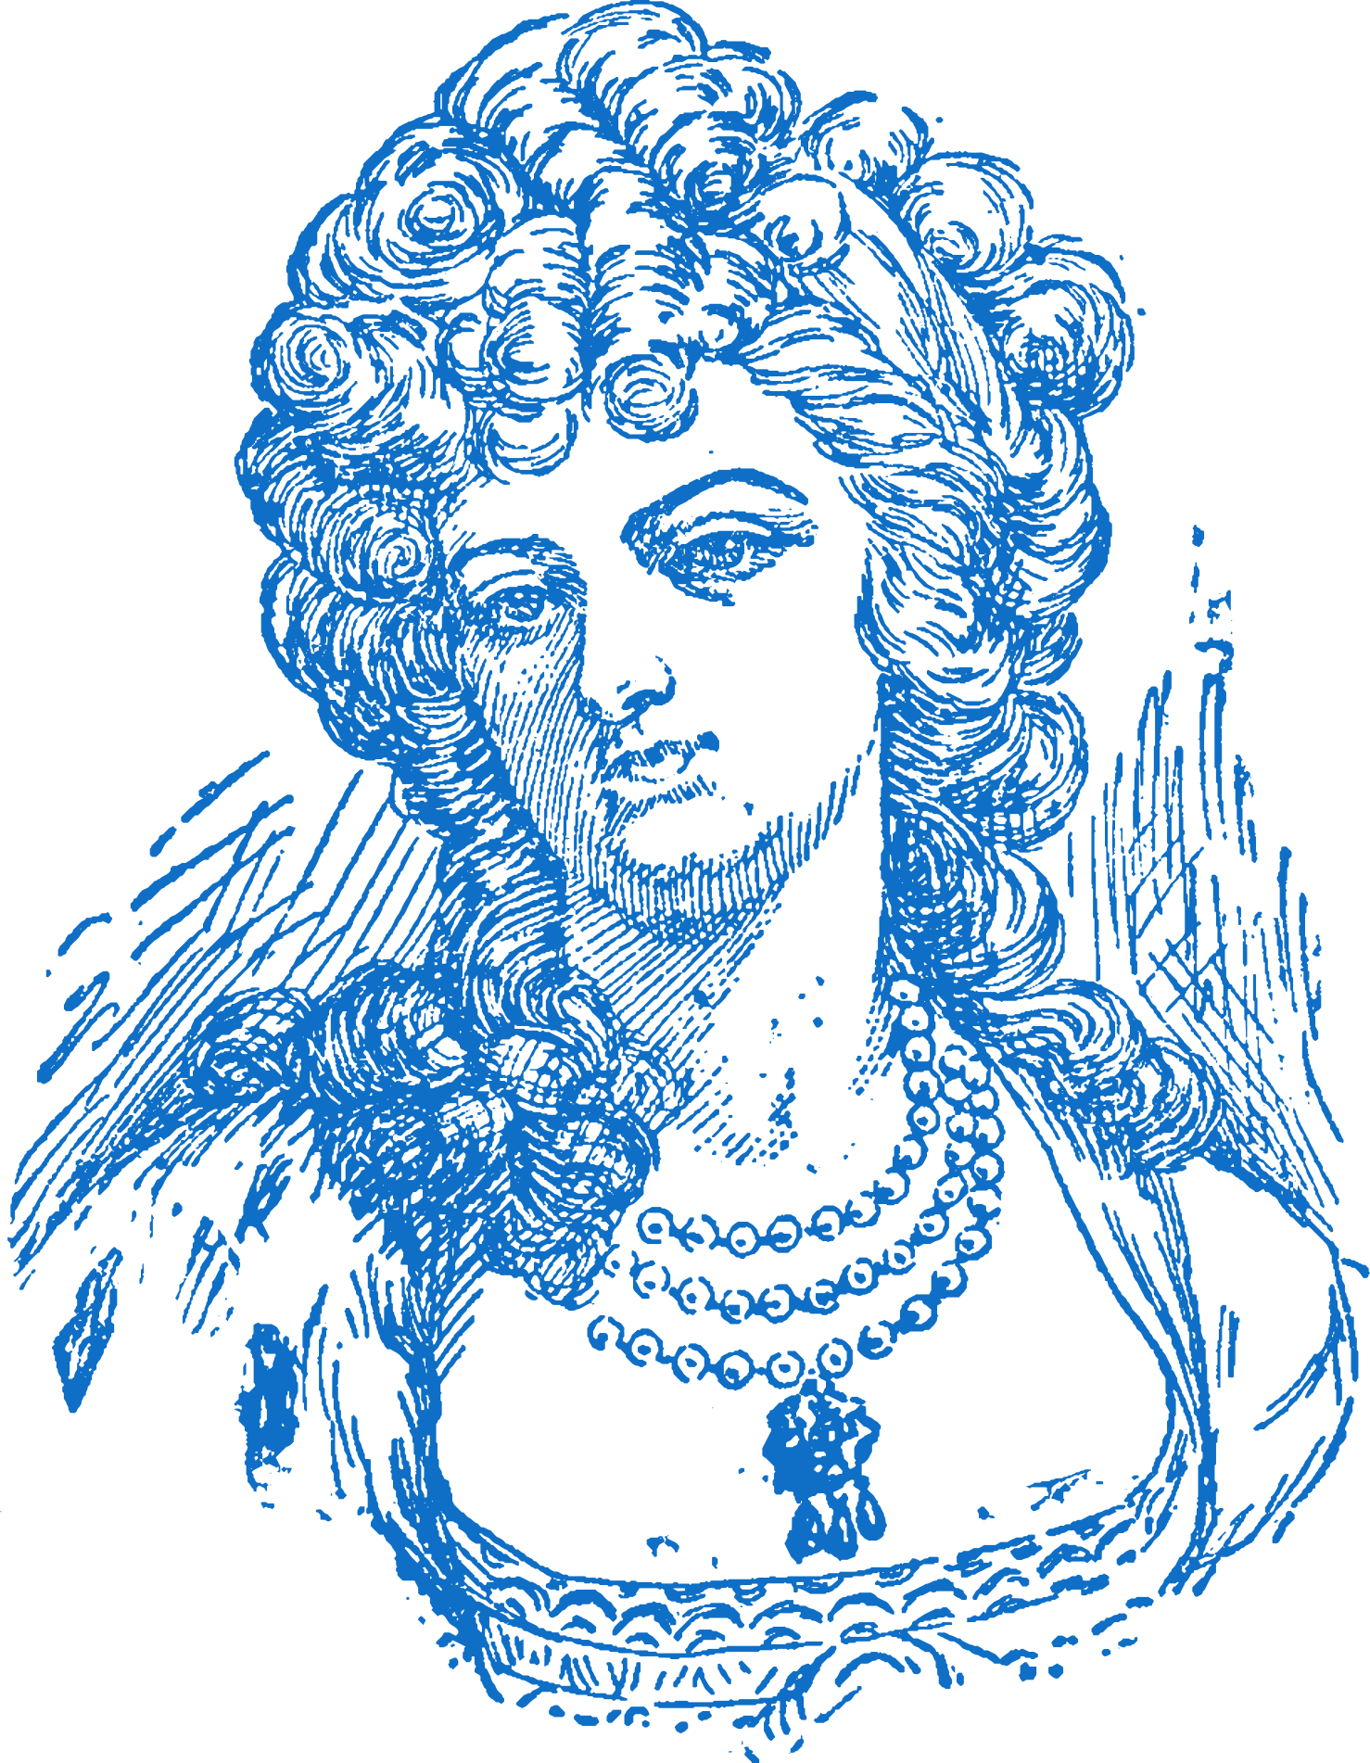
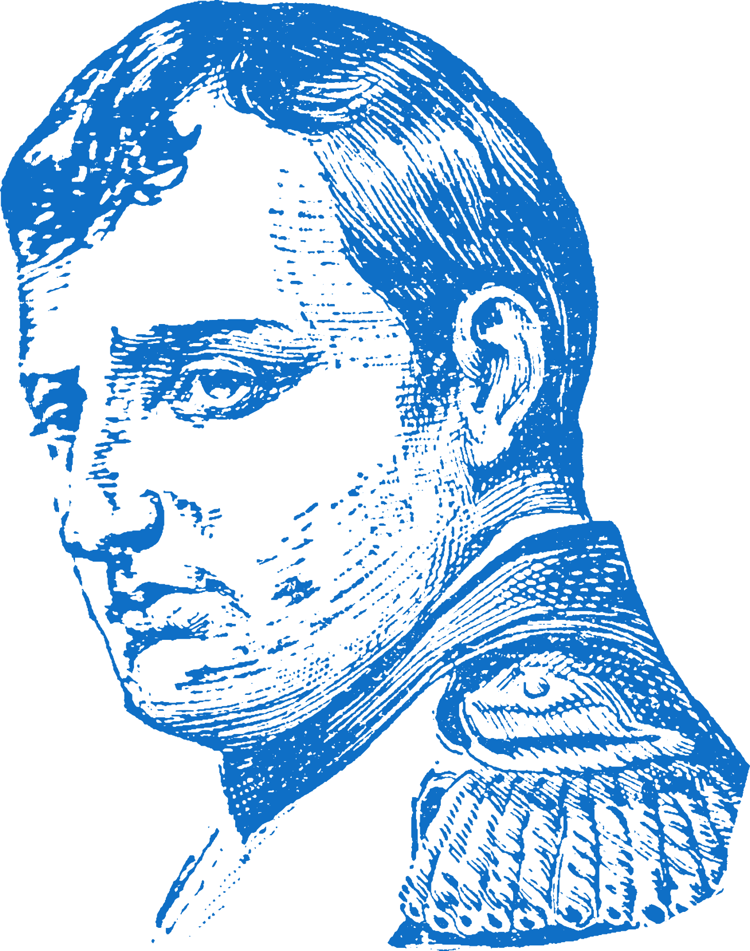
Chapter 13
THE FRENCH REVOLUTION
3.3 EXAMINE the causes, course and consequences of one revolution in pre- twentieth century Europe and/or the wider world
May-June
Estates-General Meeting and The Tennis Court Oath marks the beginning of the Revolution
Maximilien Robespierre rules through terror and fear during The Reign of Terror
King Louis XVI tries to flee France during The Flight to Varennes
Strand Three: The History of Europe and the Wider World
Chapter Thirteen: The French Revolution
1756-63
1789
1789
1791
1793
1793-94
1799
The Seven Years' War
The 'first world war' to take place. More commonly known as the French and Indian War.
July - August
The Storming of the Bastille and the Declaration of the Rights of Man marks the start of the Revolution
King Louis XVI is executed by guillotine in January; Marie Antoinette follows in October.
Coup d'état -
Napoleon Bonaparte comes to power and the French Empire is established.
@MsDoorley

Slide 3
Learning Outcomes
3.3 EXAMINE the causes, course and consequences of one revolution in pre- twentieth century Europe and/or the wider world.
1.2 CONSIDER contentious or controversial issues in history from more than one perspective and DISCUSS the historical roots of a contentious or controversial issue or theme in the contemporary world.
1.11 MAKE connections and comparisons between people, issues and events in different places and historical eras.
Strand Three: The History of Europe and the Wider World
Chapter Thirteen: The French Revolution
@MsDoorley

Slide 4
Introduction
At the end of the eighteenth century, revolutions occurred on both sides of the Atlantic that had profound effects on the course of history. A revolution is a rapid and significant change in society, politics, technology or the economy. In America, France and Ireland, people rose up to overthrow the established order. They wanted to create new ways of running society where people would have a greater say over the laws that ruled their lives.
In 1789, revolution arrived in Europe when the people of France challenged the rule of their king, Louis XVI.
Strand Three: The History of Europe and the Wider World
Chapter Thirteen: The French Revolution
@MsDoorley

Slide 5
1756 to 1783
Chapter 13
12.1: THE CAUSES OF THE FRENCH REVOLUTION
12.1: the causes of the french revolution
There was no single cause of the French Revolution.
France had many long-term problems but few people in the 1780s imagined the fall of the monarchy and the complete change that would occur in France in the years after 1789.
Strand Three: The History of Europe and the Wider World
@MsDoorley

Slide 6
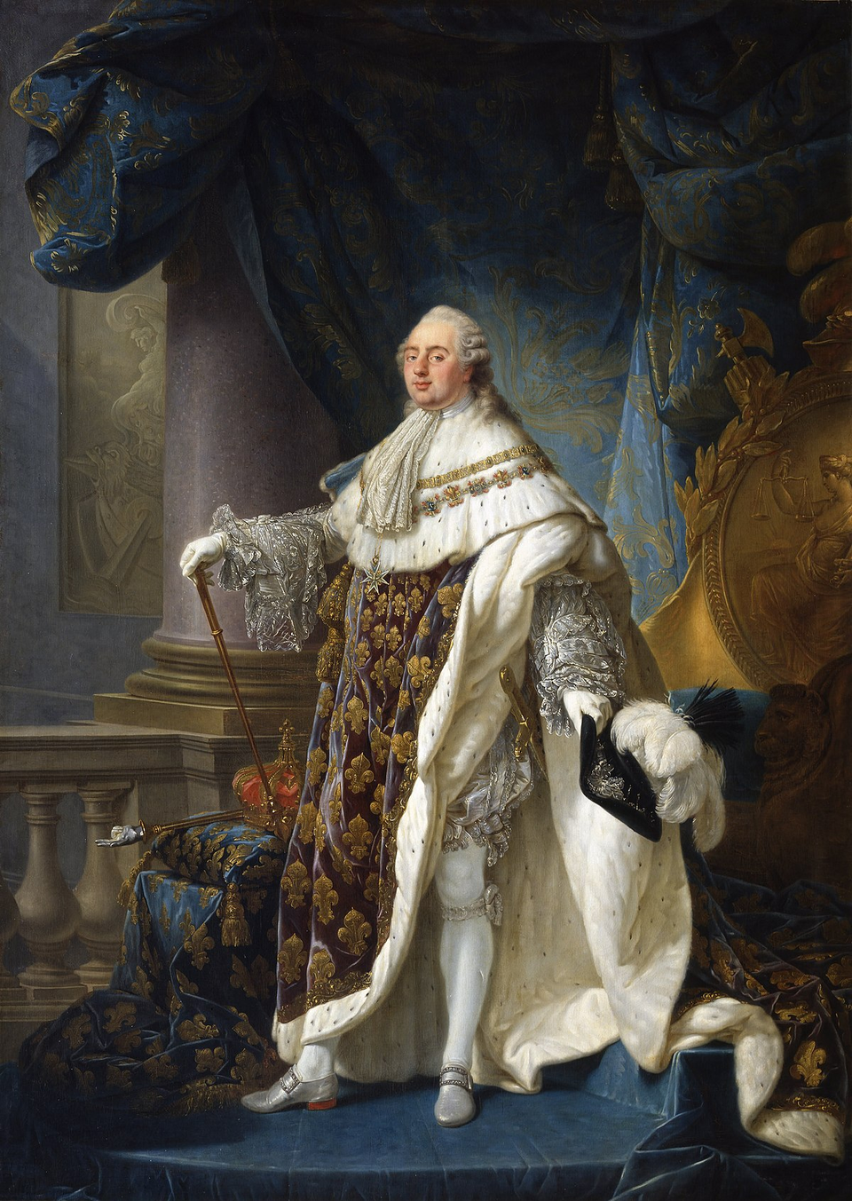
The 13 Colonies
Louis XVI ruled France in the late eighteenth century as an absolute monarch. This meant he had total power over the country and claimed he had a divine (God-given) right to rule, so could do whatever he wanted. This system could work when the king was a strong and competent ruler. Louis XVI was an awkward, clumsy man who had a good heart but was unable to relate to people on a personal level. His wife, Marie Antoinette, was Austrian and wasn’t liked by the people of France. The French Royal Family lived in the Palace of Versailles.
Strand Three: The History of Europe and the Wider World
Chapter Thirteen: The French Revolution
Diagram taken from Artefact, 2nd Edition by Eimear Jenkinson and Gregg O'Neill (educate.ie)
@MsDoorley

Slide 7
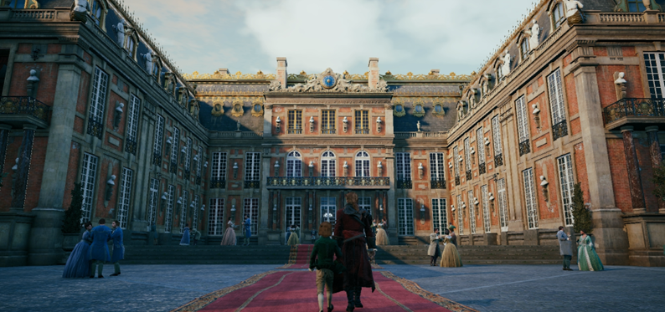
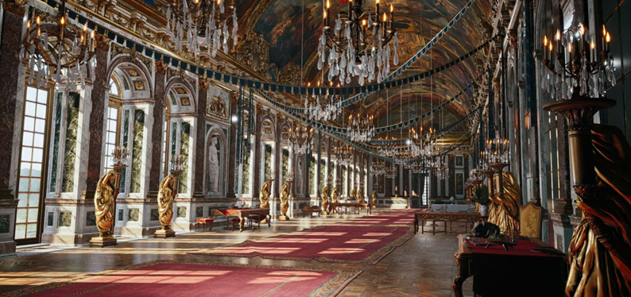
Strand Three: The History of Europe and the Wider World
Chapter Thirteen: The French Revolution
Screenshots taken from Assassin's Creed Unity, historical fiction game by Ubisoft.
@MsDoorley

Slide 8
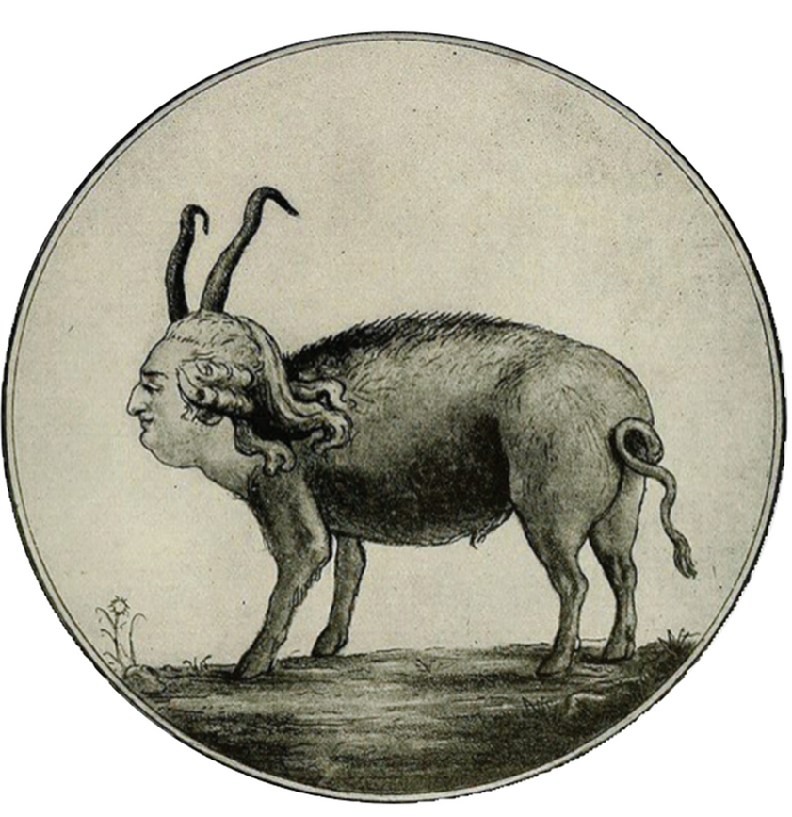
The Age of Enlightenment
The eighteenth century saw the Enlightenment emerge in Europe. This was a movement of thinker who valued reason and science above faith or authority as a basis for society. Many of these writers were French like Voltaire, Rousseau and Montesquieu. They criticised the ancien régime (the ‘old system’) of Louis’ absolute monarchy. They wrote about their ideas which many educated French people read. This lead to the desire to change the system of government so that the King had to share power with the people.
Strand Three: The History of Europe and the Wider World
Chapter Thirteen: The French Revolution
Diagram taken from Artefact, 2nd Edition by Eimear Jenkinson and Gregg O'Neill (educate.ie)
@MsDoorley

Slide 9
Social Divisions – The Ancien Régime
The society in France was made up in three Estates:
First Estate | Second Estate | Third Estate
Clergy (priests and bishops) | Nobility (wealthy landowners who controlled the government and the army) | The common people: everyone from well-off doctors, lawyers, teachers and merchants to poor peasants and workers
Approximately 100,000 people | Approximately 400,000 people | Approximately 25 million people
Did not pay taxes | Did not pay taxes | Paid taxes
Owned 10% of the land | Owned 60% of the land | Many peasants still lived under feudal law
Strand Three: The History of Europe and the Wider World
Chapter Thirteen: The French Revolution
The Third Estate, especially its wealthy and educated members, fiercely resented paying taxes when the other estates did not. The Third Estate had to pay all the taxes for the country which included:
  The taille: a land tax
  The gabelle: a salt tax
  The corvée: members of the Third Estate had to work for free repairing roads
  The tithe: one-tenth of earnings or produce went to the Catholic Church.
They also resented having to pay taxes while they had no say in running the country.
@MsDoorley

Slide 10
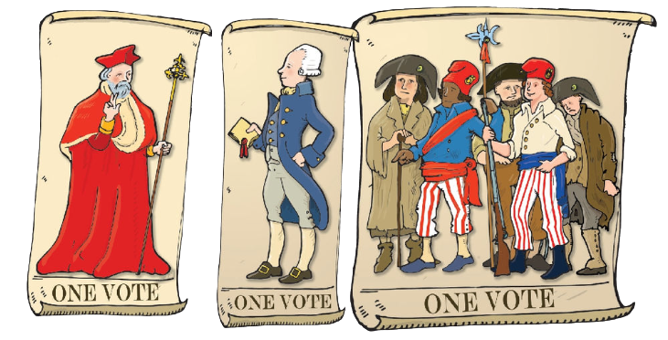
Strand Three: The History of Europe and the Wider World
Chapter Thirteen: The French Revolution
Diagram taken from Artefact, 2nd Edition by Eimear Jenkinson and Gregg O'Neill (educate.ie)
@MsDoorley

Slide 11
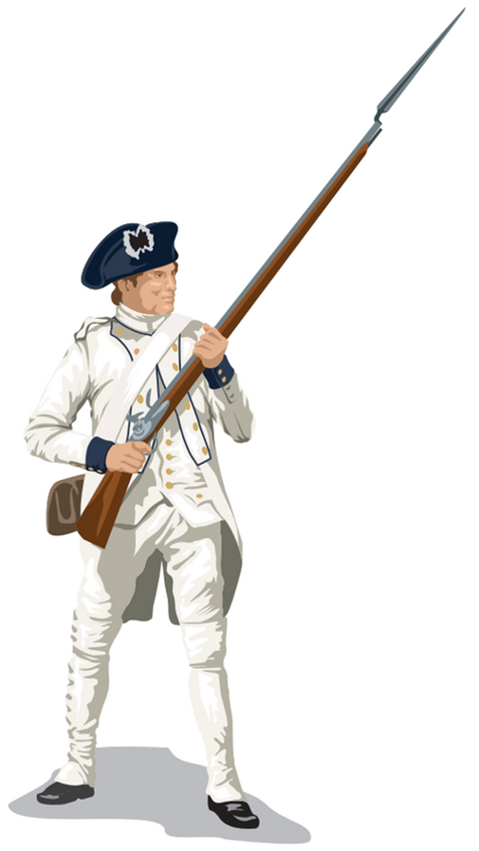
The Impact of the American Revolution
The American Revolution had a major influence on France through its successful involvement in the War of Independence. Many French were inspired by the American achievements of overthrowing the British in the name of freedom and equality. France was broke; it had been involved in two major conflicts with the British army in a short amount of time (The Seven Years War and the American War of Independence). By the end of the 1780s, France was in financial crisis with Louis urgently needing to raise taxes. The nobility refused, forcing the king to call a meeting of the Estates General.
Strand Three: The History of Europe and the Wider World
Chapter Thirteen: The French Revolution
Diagram taken from Artefact, 2nd Edition by Eimear Jenkinson and Gregg O'Neill (educate.ie)
@MsDoorley

Slide 12


Checkpoint pg. 135 (Artefact, 2nd Edition)
  What was an absolute monarch? Where did they believe their power came from?
  How did the Enlightenment thinkers challenge the ancien régime?
  What were the (a) First, (b) Second and (c) Third Estates?
  How was the Third Estate different from the other two? Give two examples.
  What taxes did the Third Estate have to pay and why did they resent them?
  How did the American Revolution impact on France?
Strand Three: The History of Europe and the Wider World
Chapter Thirteen: The French Revolution
@MsDoorley

Slide 13
Checkpoint pg. 135 (Artefact, 2nd Edition)
  Absolute monarch: a king who held total power over the country; it was thought that his authority came directly from God and he had a divine right to rule.
  The Enlightenment thinkers said that society should be based on reason and science, not on faith or authority. This helped people to feel that it was possible to challenge the view of absolute monarchs.
    First Estate: the clergy;
    Second Estate: the nobles;
    Third Estate: all other French citizens.
  Any two of: the Third Estate was larger; was not exempt from taxes; many still lived under feudal law.
  The Third Estate had to pay the taille(land tax), the gabelle (salt tax), the corvée (working for free repairing roads) and the tithe (Catholic church tax). They resented these as the other two estates were exempt, yet the Third Estate had no say in running the country.
  Many French people were inspired by the ideals of liberty and equality seen in the American colonies; the American War of Independence bankrupted France and caused the crisis that led to the calling of the Estates General in 1789.
Strand Three: The History of Europe and the Wider World
Chapter Thirteen: The French Revolution
@MsDoorley

Slide 14
1756 to 1783
Chapter 13
12.2: THE ROAD TO REVOLUTION
12.2: the road to revolution
Strand Three: The History of Europe and the Wider World
@MsDoorley

Slide 15
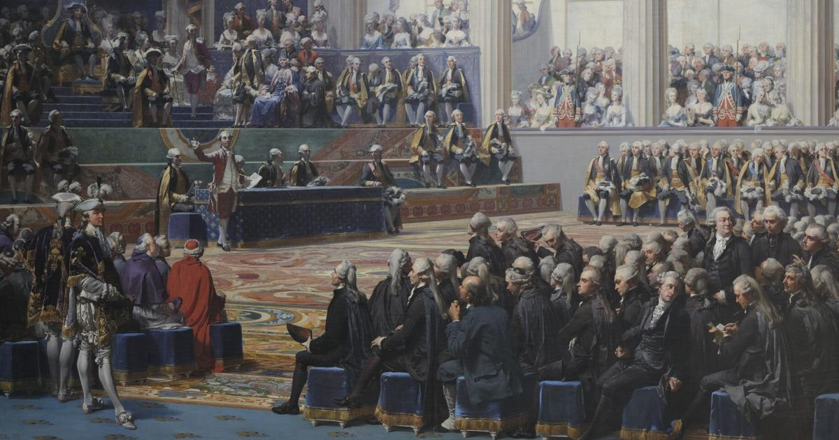
Strand Three: The History of Europe and the Wider World
Chapter Thirteen: The French Revolution
Diagram taken from Artefact, 2nd Edition by Eimear Jenkinson and Gregg O'Neill (educate.ie)
@MsDoorley

Slide 16

The Estates General
The Estates General was a kind of French parliament that made up of three parts, each representing one of the three Estates. On the 5th May 1789, the Estates General met for the first time since 1614 at the Palace of Versailles. The First Estate (308 members) and the Second Estate (285 members) wanted to preserve their privileges; the Third Estate (621 members) wanted change. Immediately, there was a huge disagreement about how voting should work; nobles and clergy wanted one vote for each estate, outnumbering the Third Estate two to one. The Third Estate wanted one vote per member to outnumber the First and Second 621 to 593.
They debated this singular issue for six weeks before the Third Estate lost their patience. They declared themselves the National Assembly – they would now represent the French People to establish a constitution. Their promise is known as The Tennis Court Oath – locked out of their meeting room, they met on the Versailles tennis courts instead to make their promise. Louis was unnerved by their decision and the rumours of violent mobs in Paris. He ordered the two other estates to join them within the National Assembly.
First Estate (308)
Strand Three: The History of Europe and the Wider World
Chapter Thirteen: The French Revolution
Third Estate (621)
Second Estate (285)
Diagram taken from Artefact, 2nd Edition by Eimear Jenkinson and Gregg O'Neill (educate.ie)
@MsDoorley

Slide 17
The Storming of the Bastille
Tensions in Paris rose during the summer of 1789 due to high food prices and shortages. Working people’s diets consisted mostly of bread. Two bad harvests puts its cost up to an impossible 88% of the daily wage – understandably, hunger (and anger) soon followed. (“Let them eat cake” - Marie Antoinette - the royal family were very much disengaged with the struggles of their people). The people of Paris feared that the king would use the army to shut down the National Assembly – they responded by creating their own militia called the National Guard.
On 14 July 1789, the mob – joined by some of the King's soldiers – stormed the Bastille. It is perceived that they were looking for guns and ammunition or to free prisoners or, perhaps, because it symbolized the power of the ancien régime and the king. The governor was capture and beaten to death while no active-duty guard was left alive. This attack would become a symbol of the crushing of the old system. The mob in Paris became known as the sans-culottes (literally ‘without short trousers’ – theirs were long, rather than the silk knee-length ones). The sans-culottes were an important force in the revolution as they continued to demand radical changes over the following years. The storming of the Bastille is considered the start of the French Revolution. Bastille Day is celebrated every 14th July as a national holiday in France.
Strand Three: The History of Europe and the Wider World
Chapter Thirteen: The French Revolution
Diagram taken from Artefact, 2nd Edition by Eimear Jenkinson and Gregg O'Neill (educate.ie)
@MsDoorley

Slide 18
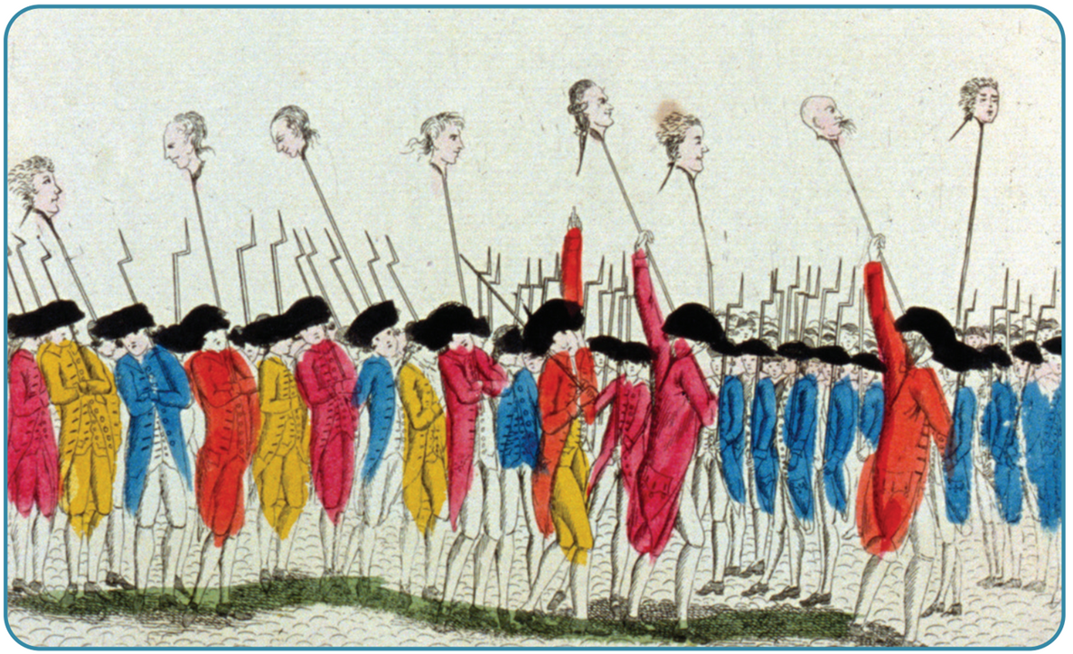
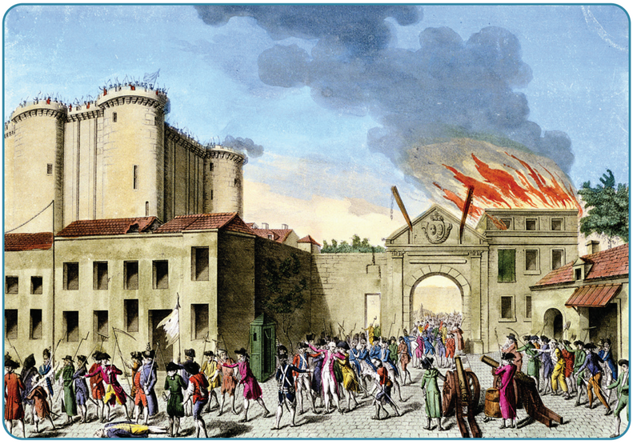
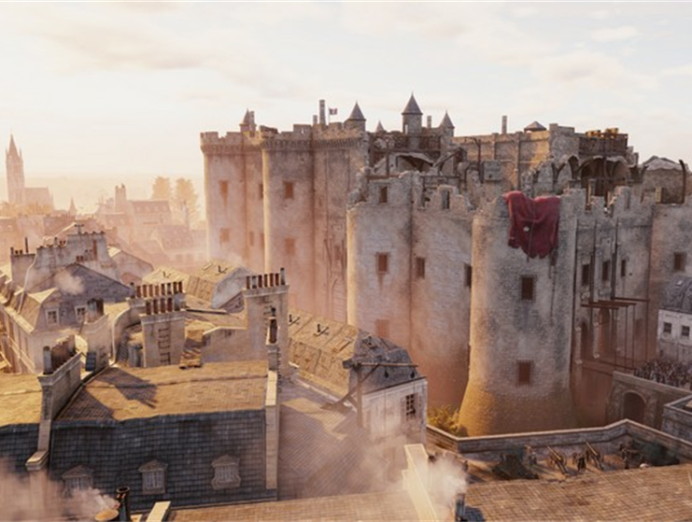
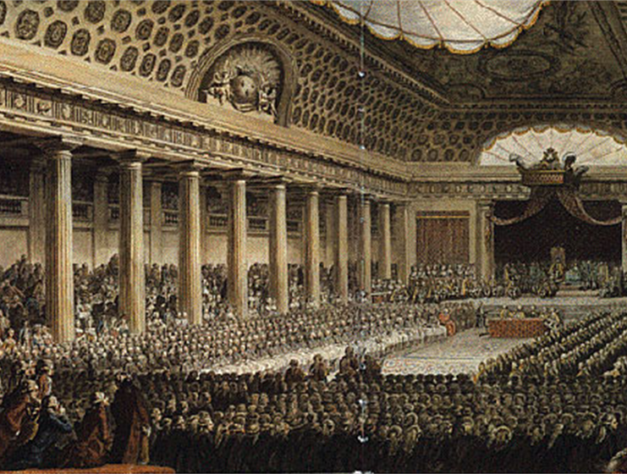
Strand Three: The History of Europe and the Wider World
Chapter Thirteen: The French Revolution
Diagram taken from Artefact, 2nd Edition by Eimear Jenkinson and Gregg O'Neill (educate.ie)
@MsDoorley

Slide 19
Checkpoint pg. 29 (Artefact, 2nd Edition)
  What was the Estates General?
  In 1789, how many years had passed since it had last met?
  Why was there a dispute over voting in the Estates General?
  What was the Tennis Court Oath?
  Why was there tensions in Paris during the summer of 1789?
  What happened on the 14th July 1789?
Strand Three: The History of Europe and the Wider World
Chapter Thirteen: The French Revolution
@MsDoorley

Slide 20
Checkpoint pg. 29 (Artefact, 2nd Edition)
  The Estates General was a kind of French parliament that was made up of three parts, each representing one of the three Estates.
  175 years.
  Traditionally, the three estates had one vote each. But there were far more members of the Third Estate than of the other two combined. The Third Estate representatives demanded that each representative get one vote each.
  The oath taken (on the Versailles tennis courts) when the Third Estate declared itself the National Assembly and swore to continue meeting until the king agreed to a constitution for France.
  The summer of 1789 saw food prices rise too high for ordinary people. There were also fears that the king would use the army to shut down the National Assembly.
  On 14 July, a Paris mob stormed the Bastille prison and executed the governor.
Strand Three: The History of Europe and the Wider World
Chapter Thirteen: The French Revolution
@MsDoorley

Slide 21
1756 to 1783
Chapter 13
13.3: REVOLUTION IN FRANCE
13.3: revolution in france
Strand Three: The History of Europe and the Wider World
@MsDoorley

Slide 22
The Reforms of the National Assembly
Events at the Bastille inspired the middle class, peasants and labourers around France to take action. Nobles’ and bishops’ houses were attacked and many of them fled abroad. The National Assembly also acted by passing sweeping reforms:
  They abolished the feudal system – all privileges of the nobility and their titles seized to exist. Everyone in France were now ‘citizens.
  The Declaration of the Rights of Man and of the Citizen was passed in 1789; this document would eventually lead to the modern document, the Universal Declaration of Human Rights. This declared that:
    All men are “born free and equal”
    All citizens have the right to “liberty, property, security and resistance to oppression."
    That “all sovereignty resides in the nation.”
    All citizens are equal before the law.
    Everyone has the freedom to speak, write and print what they want.
  The Civil Constitution of the Clergy was also passed; this abolished tithes and seized all Church property for the state. All clergy were required to take an oath of loyalty to the revolution, going as far as to remove the Pope’s power over the French Church. This law turned many devout Catholics against the Revolution.
Strand Three: The History of Europe and the Wider World
Chapter Thirteen: The French Revolution
@MsDoorley

Slide 23
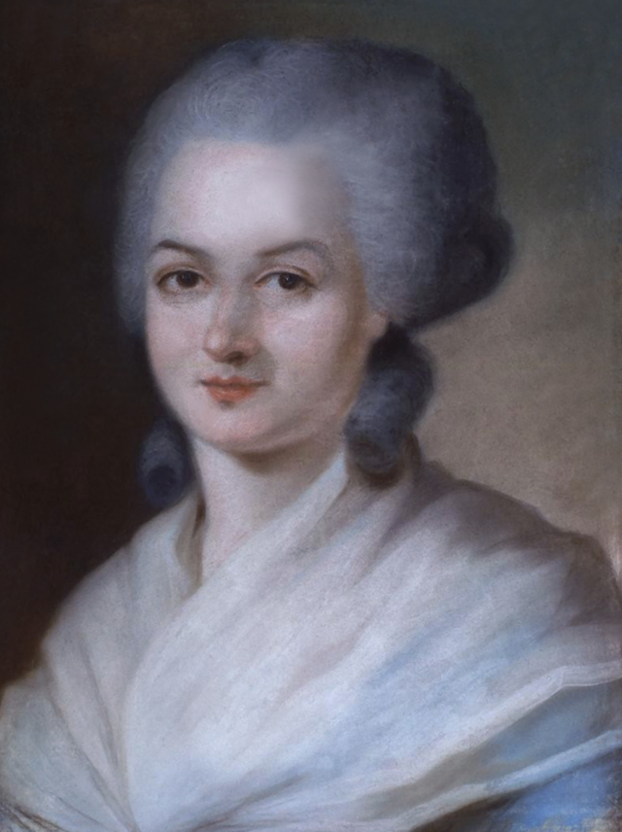
Olympe de Gouges, 1748-1793
Olympe de Gouges was a writer and activist during the French Revolution. After the death of her husband, she moved to Paris and vowed never to marry again. There she became active in political causes and hosted salons (social gatherings) for prominent radical politicians and thinkers. She wrote and campaigned on issues from road improvement to divorce, maternity hospitals, the abolition of slavery, and the rights of orphaned children and of unmarried mothers. In 1791, as a reply to The Declaration of the Rights of Man and of the [Male] Citizen, she published The Declaration of the Rights of Woman and of the [Female] Citizen, in which she argued that women have the same rights as men. She wrote on behalf of the more moderate groups in the National Assembly and she was arrested and executed by guillotine in July 1793 as part of the Reign of Terror. Her writings were widely read after her death and she is considered to be France's first feminist writer.
Strand Three: The History of Europe and the Wider World
Chapter Thirteen: The French Revolution
Diagram taken from Artefact, 2nd Edition by Eimear Jenkinson and Gregg O'Neill (educate.ie)
@MsDoorley

Slide 24
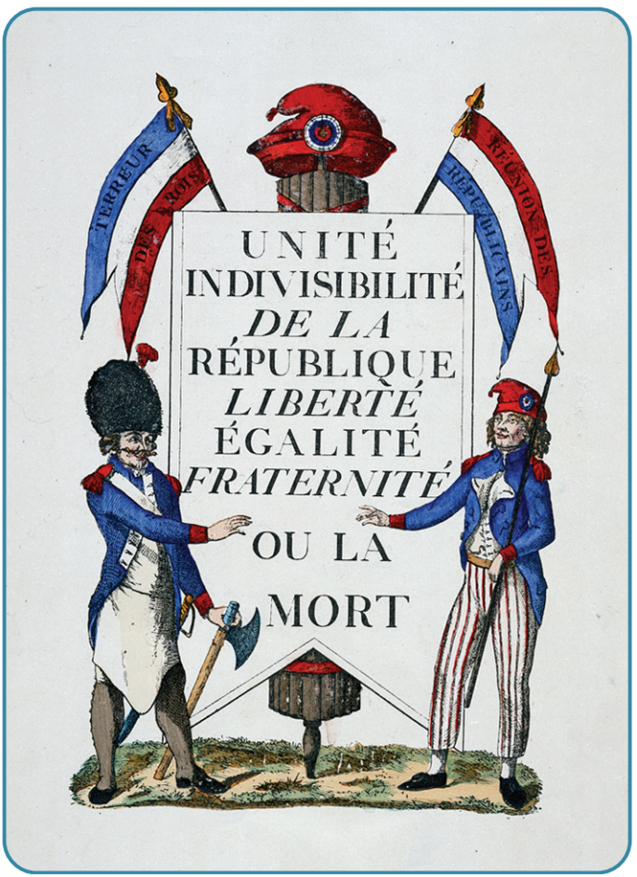
Symbols of the revolution
The aims of the revolutionaries were summed up in the slogan ‘Liberté, Égalite, Fraternité’
  Liberty: all men are free.
  Equality: all men are equal.
  Fraternity: all men should treat each other as brothers.
The revolutionaries also adopted a new flag for France. It became a tricolour with blue and red (the colours of Paris) on either side of the white of the royal family. This was to symbolise that the people were now dominant over royalty.
Strand Three: The History of Europe and the Wider World
Chapter Thirteen: The French Revolution
Diagram taken from Artefact, 2nd Edition by Eimear Jenkinson and Gregg O'Neill (educate.ie)
@MsDoorley

Slide 25
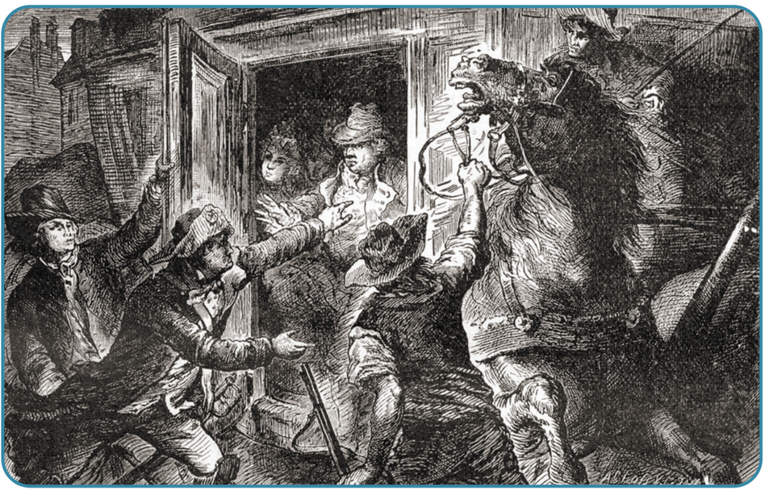
The Flight to Varennes
Many people in Paris feared the King and Queen were opposed to the revolution and would try to reverse it. In October 1789, thousands of ordinary working women of Paris armed themselves and marched the six hours to Versailles. They forced the royal family to return to Paris where they were confined to the Tuileries Palace. Louis wanted the support of other European monarchs to crush the revolution; no monarch wanted these revolutionary ideas to spread to their countries. Louis looked to his brother-in-law, Emperor Leopold of Austria, for help. He planned to escape to the Austrian-controlled Netherlands (modern Belgium) with his family. In June 1791, Louis and Marie Antoinette slipped out of Paris disguised as servants. They were caught near the border, at the town of Varennes. Many people were convinced the king was conspiring with foreign powers against his own people and he was stripped of most of his powers.
Strand Three: The History of Europe and the Wider World
Chapter Thirteen: The French Revolution
Diagram taken from Artefact, 2nd Edition by Eimear Jenkinson and Gregg O'Neill (educate.ie)
@MsDoorley

Slide 26
The War With Austria
Austria was seen as the main foreign threat. The National Assembly declared war on Austria in April 1792 in an attempt to strike before the Austrians were ready to attack them. The French forces that were ill-prepared. Many army officers (who were nobles) had fled and the army lacked good leaders.
The Austrians were joined by the Prussians, winning several victories over the French. The sans-culottes of Paris suspected King Louis of helping France’s enemies. In August, they stormed the Tuileries Palace. The royal family was imprisoned by the National Assembly.
French fortunes in the war improved after appeal was made to the people to save the revolution. Huge numbers joined the army, overwhelming the invaders on the battlefield.
The sans-culottes demanded more radical reforms. In September 1792, the new National Convention declared France a republic (a type of government without a king, where the people were sovereign). During the celebrations, mobs broke into various Paris prisons and executed 1,000 ‘enemies of the revolution’ during the September Massacres.
Strand Three: The History of Europe and the Wider World
Chapter Thirteen: The French Revolution
Diagram taken from Artefact, 2nd Edition by Eimear Jenkinson and Gregg O'Neill (educate.ie)
@MsDoorley

Slide 27

The execution of the King
Documents found in a safe in the Tuileries Palace implied Louis had been working with France’s foreign enemies. He was tried by the Convention and found guilty by a small majority (387 to 334). He was executed at the guillotine in January 1793. Nine months later, Marie Antoinette met the same fate. These executions outraged the rest of Europe; Britain, Spain and the Netherlands declared war on France. This crisis would lead to the coming to power of Maximillien Robespierre and the Committee of Public Safety.
Strand Three: The History of Europe and the Wider World
Chapter Thirteen: The French Revolution
Did you know?
The guillotine was originally invented as a more humane method of execution than hanging, but became a symbol of the brutality of the French Revolution.
@MsDoorley

Slide 28

Strand Three: The History of Europe and the Wider World
Chapter Thirteen: The French Revolution
Screenshots taken from Assassin's Creed Unity, historical fiction game by Ubisoft.
@MsDoorley

Slide 29

Strand Three: The History of Europe and the Wider World
Chapter Thirteen: The French Revolution
Screenshots taken from Assassin's Creed Unity, historical fiction game by Ubisoft.
@MsDoorley

Slide 30
Checkpoint pg. 153 (Artefact, 2nd Edition)
  How did the revolution change the positions of (a) nobles and (b) clergy in France?
  What were the main points of The Declaration of the Rights of Man and of the Citizens?
  What was the flight to Varennes and what were the results of it?
  How did other European countries react to the events in France?
  Why was Louis XVI executed?
Strand Three: The History of Europe and the Wider World
Chapter Thirteen: The French Revolution
@MsDoorley

Slide 31
Checkpoint pg. 153 (Artefact, 2nd Edition)
    The revolution abolished the feudal system, all privileges of the nobility and all titles;
    The revolution abolished tithes, seized all Church property for the state, required all clergy to take an oath of loyalty to the revolution and removed the Pope’s power over the French Church.
  All men are born free and equal; all citizens have the right to liberty, property and security; all citizens are equal before the law; everyone has the freedom to speak, write and publish what they want.
  To seek the support of other European monarchs to crush the revolution.
  Other European countries were worried that the revolution would spread to their countries. France declared war on Austria and eventually defeated them; Britain, Spain and the Netherlands declared war on France after the executions of the king and queen.
  Louis XVI was found guilty of treason by a small majority of the National Assembly.
Strand Three: The History of Europe and the Wider World
Chapter Thirteen: The French Revolution
@MsDoorley

Slide 32
Keywords Quiz - 12th October 2023
  A political system in which the king or queen has sole power to decide the laws without the restriction of a government or constitution.
  A group of twelve men selected by the National Convention in 1793 to govern France. It was dominated by Mazimilien Robespierre.
  A noble who fled France during the Revolution.
  A group of politicians with extreme ideas who supported the Revolution.
  rule by the people'; a form of government where the people decide how the country is run and who will represent them.
  Outlined basic rights that people were entitled to, e.g. freedom of religion and freedom of speech.
  Peasants of the Third Estate were required to provide unpaid labour instead of tax payments. - Corvée
  The middle class or wealthier members of the Third Estate.
  The political system in France before the 1789 Revolution.
  A medieval fortress in Paris that was used as a prison for enemies of the king.
  Absolute monarch
  Ancien Régime
  Bastille
  Bourgeoisie
  Committee of Public Safety
  Corvée
  Declaration of the Rights of Man and the Citizen
  Democracy
  Émigré
  Jacobins
Strand Three: The History of Europe and the Wider World
Chapter Thirteen: The French Revolution
@MsDoorley

Slide 33
Keywords Quiz - 12th October 2023
  A political system in which the king or queen has sole power to decide the laws without the restriction of a government or constitution. - Absolute Monarchy
  A group of twelve men selected by the National Convention in 1793 to govern France. It was dominated by Mazimilien Robespierre. - Committee of Public Safety
  A noble who fled France during the Revolution. - Émigré
  A group of politicians with extreme ideas who supported the Revolution. - Jacobins
  ‘rule by the people'; a form of government where the people decide how the country is run and who will represent them. - Democracy
  Outlined basic rights that people were entitled to, e.g. freedom of religion and freedom of speech. - Declaration of the Rights of Man and the Citizen
  Peasants of the Third Estate were required to provide unpaid labour instead of tax payments. - Corvée
  The middle class or wealthier members of the Third Estate. - Bourgeoisie
  The political system in France before the 1789 Revolution. - Ancien Régime
  A medieval fortress in Paris that was used as a prison for enemies of the king. - Bastille
Strand Three: The History of Europe and the Wider World
Chapter Thirteen: The French Revolution
@MsDoorley

Slide 34
1756 to 1783
Chapter 13
13.4: THE REIGN OF TERROR
13.4: the reign of terror
Strand Three: The History of Europe and the Wider World
@MsDoorley

Slide 35
The Committee of Public Safety
After the rest of Europe declared war on France, the National Convention set up a Committee of Public Safety in April 1793. Its aim was to save the revolution and destroy its enemies, both inside and outside France. It had 12 members and Maximilien Robespierre was its president. The Committee faced several major problems:
  The upper classes continued to oppose the revolution.
  Violent opposition to the revolution broke out in the Vendée region
  The war dragged on against many of Europe’s strongest states.
  Food prices continued to rise
Strand Three: The History of Europe and the Wider World
Chapter Thirteen: The French Revolution
@MsDoorley

Slide 36
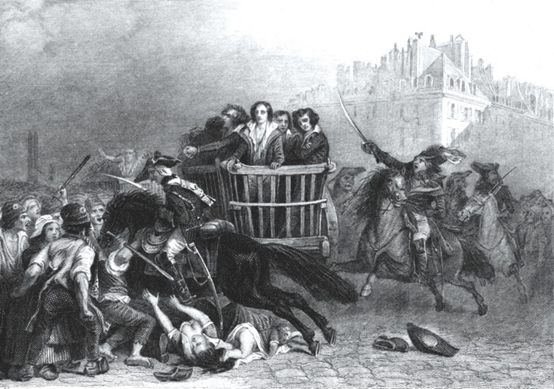
The Reign of Terror
The Committee assumed absolute power and launched the Reign of Terror.
  The Law of Suspects was passed, punishing anyone even suspected of betraying the revolution. Tens of thousands were arrested – often with very little evidence against them. Between June 1793 and July 1794, over 16,000 people were guillotined. Over 80% of these executions took place outside Paris.
  The rebellion in the Vendée was put down with great savagery, killing nearly 250,000.
  Another mass enlistment made the French army so massive (over 1 million men) that it outnumbered all their opponents put together, saving the revolution from external threats.
  The Law of Maximum controlled the rising prices for food and other goods. Harsh punishments (excluding execution) were used on those found to be overcharging citizens.
Strand Three: The History of Europe and the Wider World
Chapter Thirteen: The French Revolution
Diagram taken from Artefact, 2nd Edition by Eimear Jenkinson and Gregg O'Neill (educate.ie)
@MsDoorley

Slide 37
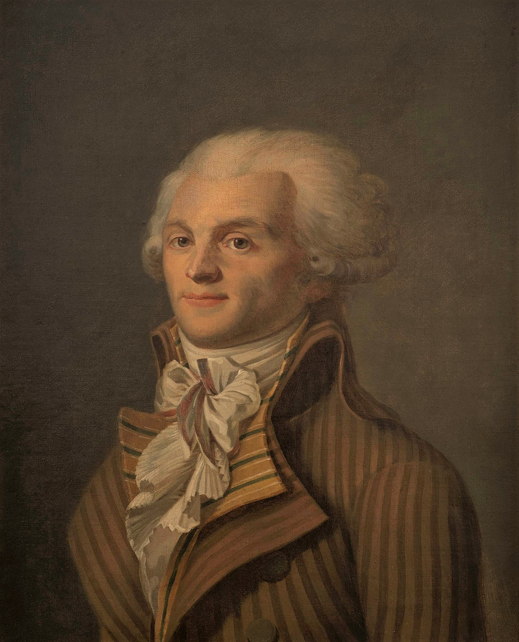
Maximilien Robespierre, 1758-1794
Maximilien Robespierre was born in 1758 in the small town of Arras. He trained as a lawyer and in 1789 he was elected for the Third Estate to the Estates General, where he quickly rose to prominence. He was known as ‘the incorruptible’ because he was considered completely honest and sincere. He was a leading member of the Jacobins (a radical political group) and was very popular with the Paris sans-culottes. As the war worsened, he grew to believe that ruthless actions were needed to protect the Revolution. He was elected the president of the Committee of Public Safety in April 1793 and held nearly complete power during the Reign of Terror. He was eventually overthrown and executed by guillotine in July 1794.
Strand Three: The History of Europe and the Wider World
Chapter Thirteen: The French Revolution
Diagram taken from Artefact, 2nd Edition by Eimear Jenkinson and Gregg O'Neill (educate.ie)
@MsDoorley

Slide 38
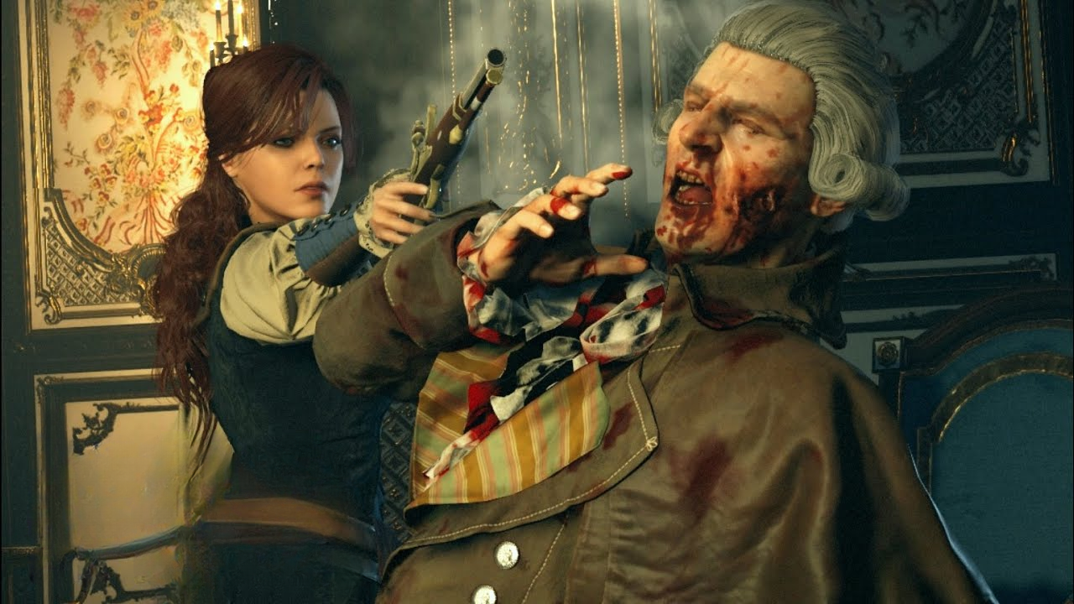
The End of the Reign of Terror
By June 1794, the immediate danger to the revolution seemed to have passed and the military situation had improved considerably. People expected the Terror to come to an end – instead, Robespierre intensified it, now targeting members of the National Convention. Many feared that Robespierre had too much power. The sans-culottes turned against him and he was attacked in speeches in the Convention. He was jeered with ‘Down with the tyrant!’ in the streets. His fellow Committee members feared the they would be next – so they acted first. On 27th July 1794, Robespierre was arrested (along with his supporters) where he was shot in the jaw. He would later be executed a few hours later. The Convention elected a five-member Directory to run a more moderate government. This is considered to mark the end of the French Revolution.
Strand Three: The History of Europe and the Wider World
Chapter Thirteen: The French Revolution
Screenshots taken from Assassin's Creed Unity, historical fiction game by Ubisoft.
@MsDoorley

Slide 39
Checkpoint pg. 142 (Artefact, 2nd Edition)
  Why was the Committee of Public Safety formed?
  Name two challenges the Committee faced and explain how it dealt with them.
  What led to Robespierre’s fall from power?
Strand Three: The History of Europe and the Wider World
Chapter Thirteen: The French Revolution
@MsDoorley

Slide 40
Checkpoint pg. 142 (Artefact, 2nd Edition)
  The revolution was endangereddue to the war and so the assembly established the committee to save the revolution and destroy its enemies, both inside and outside France.
  Key task here is for students to link the challenge with the response. For example: opposition to the revolution from the upper classes – the Law of Suspects meant that large numbers of people were executed simply for being accused of being against the revolution.
  Despite the threat from the war receding, Robespierre continued and expanded the Terror. Fearing that he would target them next, the other members of the Committee had him arrested and executed.
Strand Three: The History of Europe and the Wider World
Chapter Thirteen: The French Revolution
@MsDoorley

Slide 41
Checkpoint pg. 142 (Artefact, 2nd Edition)
  The revolution was endangered due to the war and so the assembly established the committee to save the revolution and destroy its enemies, both inside and outside France.
  Key task here is for students to link the challenge with the response. For example: opposition to the revolution from the upper classes – the Law of Suspects meant that large numbers of people were executed simply for being accused of being against the revolution.
  Despite the threat from the war receding, Robespierre continued and expanded the Terror. Fearing that he would target them next, the other members of the Committee had him arrested and executed.
Strand Three: The History of Europe and the Wider World
Chapter Thirteen: The French Revolution
@MsDoorley

Slide 42
1756 to 1783
Chapter 13
13.5: THE RESULTS OF THE FRENCH REVOLUTION
13.5: the results of the french revolution
Strand Three: The History of Europe and the Wider World
@MsDoorley

Slide 43
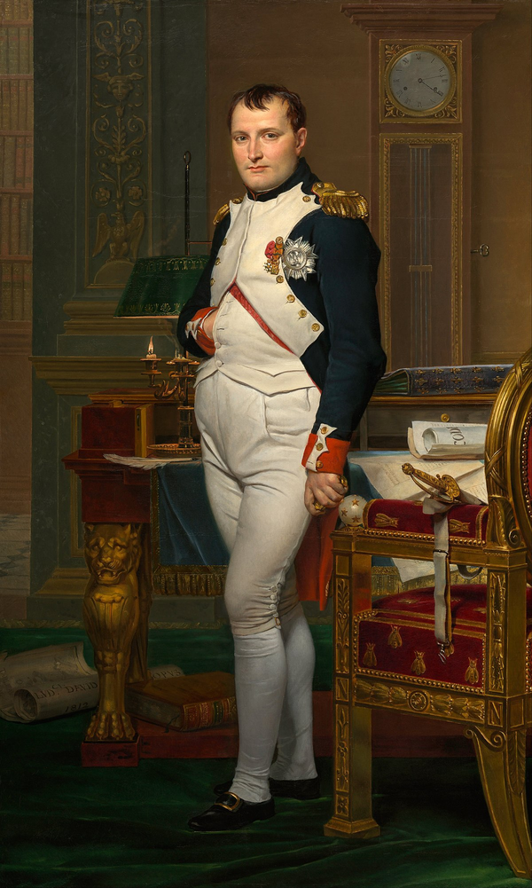
The Rise of Napoleon
The Directory was overthrown by Napoleon Bonaparte (1769-1821), who declared himself Emperor of France in 1804. He conquered most of Europe before he was defeated at the Battle of Waterloo in 1815.
Strand Three: The History of Europe and the Wider World
Chapter Thirteen: The French Revolution
@MsDoorley

Slide 44

The spread of the revolution's ideals
The Revolution’s slogan of ‘Liberty, Equality, Fraternity’ spread to other European countries and more people demanded freedom and equality. People called for more democracy (‘rule by the people’, or a say in how their countries were run) and the power of monarchs was reduced. The French flag, inspired by that of the Netherlands, would go on to inspire many other tricolour flags such as Ireland and Italy.
Strand Three: The History of Europe and the Wider World
Chapter Thirteen: The French Revolution
The Netherlands
France
Ireland
Italy
Romania
Belgium
Chad
Ivory Coast
Guinea
@MsDoorley

Slide 45
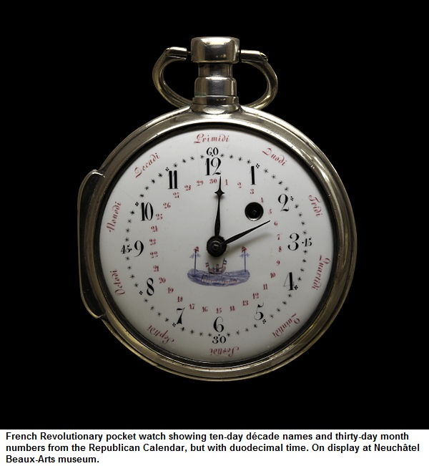
The metric system
One innovation of the revolution that survived was the metric system of weights and measures. The metric system (and decimalisation, for currency) is based on multiples of ten; the older ‘imperial system’ made calculations far more complicated. However, the revolution’s ten-day weeks and new calendar proved less popular.
Strand Three: The History of Europe and the Wider World
Chapter Thirteen: The French Revolution
Diagram taken from Artefact, 2nd Edition by Eimear Jenkinson and Gregg O'Neill (educate.ie)
@MsDoorley

Slide 46
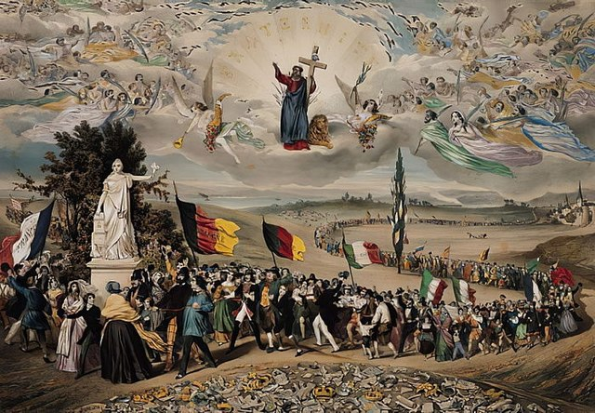
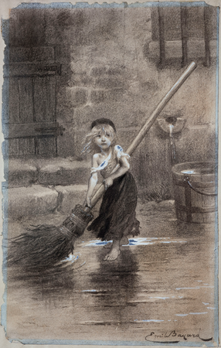
The spread of the revolution's ideals
Across Europe the power of nobility was reduced, as the middle classes gained more political power. This was helped by the fact that many European countries saw how successful the huge French revolutionary armies had been and copied them. As more people fought and gained military experience, they demanded more power in their countries. The French Revolution marked the Birth of a Nation (modern nationalism) - the desire to rule the nation by its own people and not Imperial powers. This came to a height in 1848, where revolution broke out in modern-day Ireland, Italy, France, German, Denmark, Hungary, Sweden, Switzerland, Poland, Romania, Belgium, Spain, and Serbia.
Strand Three: The History of Europe and the Wider World
Chapter Thirteen: The French Revolution
Did you know?
Les Misérables, a French historical novel which has been adapted into Les Misérables: The Musical, sees the characters being swept up in the French Revolution of 1848.
@MsDoorley

Slide 47
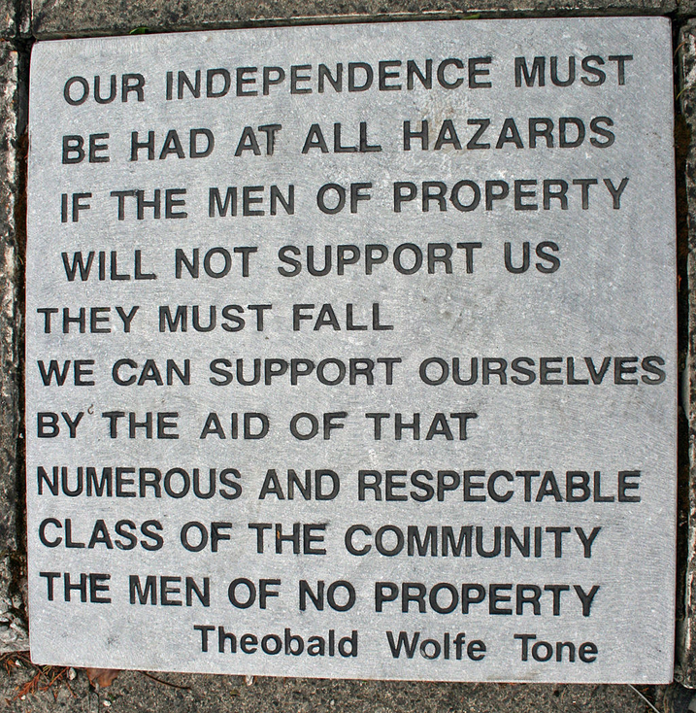
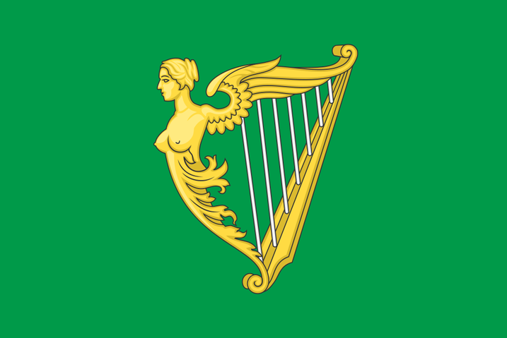
The Impact on Ireland
The ideals of the French Revolution inspired some Irishmen to fight for the liberty of Ireland and for equality between people of all religious faiths. One group, the United Irishmen, staged their own revolution in 1798. They received military aid from the French government.
Strand Three: The History of Europe and the Wider World
Chapter Thirteen: The French Revolution
@MsDoorley

Slide 48
Checkpoint pg. 155 (Artefact, 2nd Edition)
  Explain the impact the French Revolution had on (a) France; (b) Europe; and (c) Ireland.
  Which of the results of the French Revolution do you think is the most important? Explain your answer.
Strand Three: The History of Europe and the Wider World
Chapter Thirteen: The French Revolution
@MsDoorley

Slide 49
1517 to 1650
Chapter 13
13.6: SUMMARY
13.6: summary
Strand Three: The History of Europe and the Wider World
@MsDoorley

Slide 50
In this chapter, we have learned that...
The causes of the French Revolution can be divided into long term and short term causes:
Long-term Casues | Short-Term Causes
France's absolute monarchy | The calling of the Estates General
The Enlightenment | The Tennis Court Oath
Social Divisions in France | The Storming of the Bastille
The American Revolution
Strand Three: The History of Europe and the Wider World
Chapter Thirteen: The French Revolution
  The revolution brought huge change to France: the end of the power of the nobility and the clergy; the declaration of the republic; the declaration of the rights of citizens; and a new flag.
  Other European states were alarmed by the revolution, leading to war with Austria. After the execution of Louis XVI, other European states joined the war against France.
  This war led to a crisis in France, which saw the creation of the Committee of Public Safety under Maximilien Robespierre, and the Reign of Terror, which saw thousands of people executed for opposing the revolution.
  The revolution had a profound effect on France and the rest of the world. It inspired others to fight for the ideals of ‘Liberty, Equality and Fraternity’ in their own countries.
@MsDoorley

Slide 51
Reflecting on... the American Revolution
This turning point in European history ended the era of absolute monarchs and the ‘divine right’ of kings. It proved the power of ideas and showed that people were prepared to protest, campaign and fight for a freer and more equal world. But it also had a dark side. The violence unleashed to bring down the ancien regime also led to the death of huge numbers of other people. These two aspects of political revolution – a passionate desire for a better world and an intense violence – would be a feature of nearly every large-scale revolution for the next two centuries.
Strand Three: The History of Europe and the Wider World
Chapter Thirteen: The French Revolution
@MsDoorley

Slide 52
Examination Questions
2022 SEC Q4
Strand Three: The History of Europe and the Wider World
Chapter Thirteen: The French Revolution
@MsDoorley

Slide 53
Project
Guidelines:
  Length: The depth of your project should reflect about 2-3 weeks of work.
  Sources: Use at least three different sources for your research. These can be books, scholarly articles, or reputable online resources.
  Citations: All information and images that are not your own should be properly cited.
  Mediums: You may choose to present your project in one of the following ways:
    Poster: Your poster should be informative and visually engaging.
    Minecraft or Lego Model: If choosing this option, please also include a brief report explaining your model.
    Painting/Drawing: Your artwork should be accompanied by a description.
    Recycled Materials: Create your model using recycled materials and provide an explanation of your creative process.
Assessment:
Your projects will be assessed based on:
  Research and Content
  Creativity and Presentation
  Understanding of Context
  Adherence to Guidelines
Strand Three: The History of Europe and the Wider World
Chapter Thirteen: The French Revolution
@MsDoorley

Slide 54
Project
Historical Sites
Historical Figures
Place de la Bastille, Paris, France
Palace of Versailles, Hall of Mirrors, France
Place de la Concorde, Paris, France
Tuileries Palace Gardens, Paris, France
Varennes-en-Argonne, France
Napoleon Bonaparte
Jacques-Pierre Brissot
Charles de Calonne
Lazare Carnot
Marquis de Lafayette
Louis XVI
Marie-Antoinette
Jacques Necker
Maximilien Robespierre
Emmanuel-Joseph Sieyès
Strand Three: The History of Europe and the Wider World
Chapter Thirteen: The French Revolution
@MsDoorley

